Slide 1
Genetic Algorithms

Slide 2
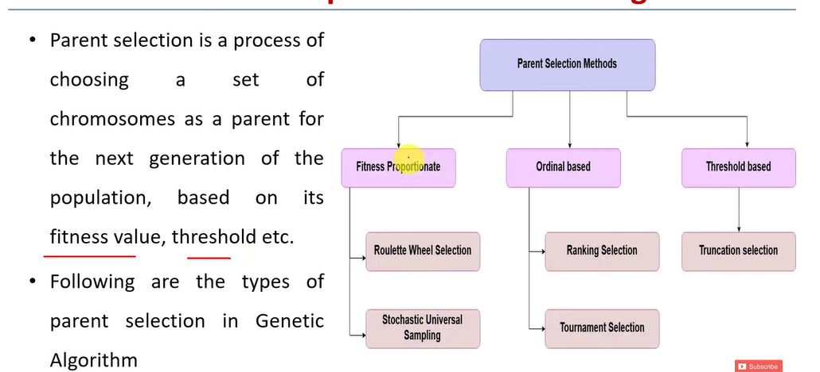
Parents selection operators

Slide 3
Fitness Proportionate Selection
Fitness Proportionate Selection is one of the most popular ways of parent selection.
In this every individual can become a parent with a probability which is proportional to its fitness
Two implementations of fitness proportionate selection are possible −
Roulette Wheel Selection
Stochastic Universal Sampling (SUS)

Slide 4
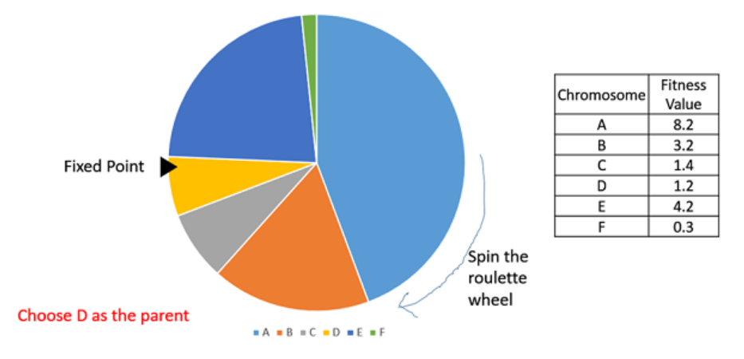
1. Roulette Wheel Selection
A fixed point is chosen on the wheel circumference as shown and the wheel is rotated.
The region of the wheel which comes in front of the fixed point is chosen as the parent.
For the second parent, the same process is repeated.

Slide 5
2. Stochastic Universal Sampling (SUS)
Stochastic Universal Sampling is quite similar to Roulette wheel selection,
however instead of having just one fixed point, we have multiple fixed points as shown in the following image.
Therefore, all the parents are chosen in just one spin of the wheel.
Also, such a setup encourages the highly fit individuals to be chosen at least once.

Slide 6
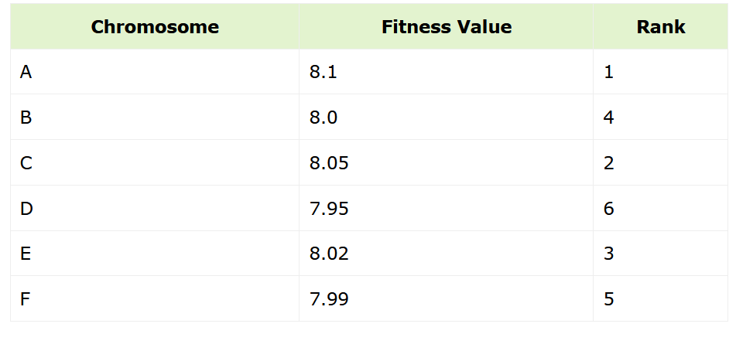
Ordinal based
Every individual in the population is ranked according to their fitness.
However, every chromosome will be given equal share on the Roulette wheel

Slide 7
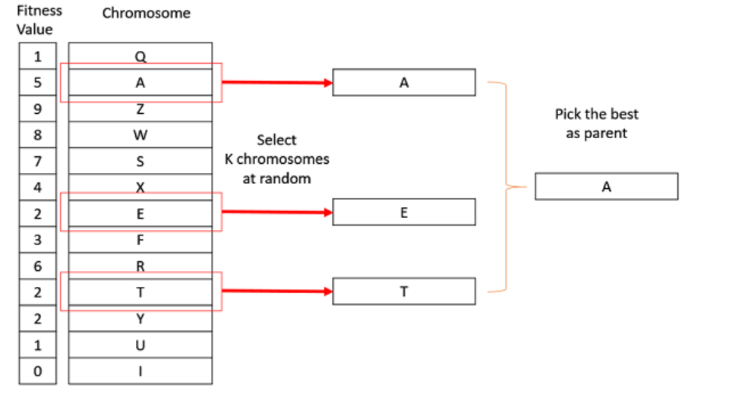
Tournament Selection
In K-Way tournament selection, we select K individuals from the population at random and select the best out of these to become a parent. The same process is repeated for selecting the next parent
Tournament Selection is also extremely popular in literature as it can even work with negative fitness values.

Slide 8
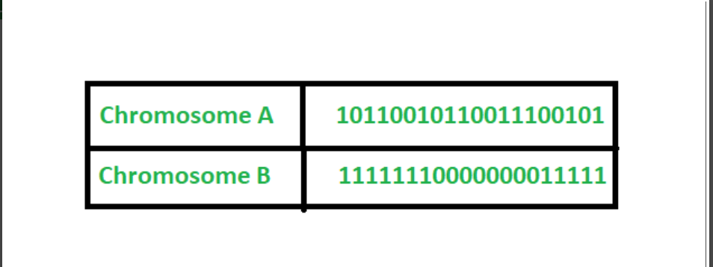
Encoding techniques
Binary Encoding: Most common methods of encoding. Chromosomes are string of 1s and 0s and each position in the chromosome represents a particular characteristics of the solution.

Slide 9
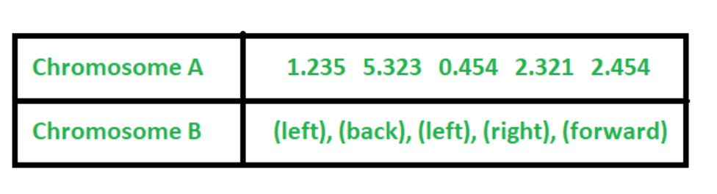
Encoding techniques
Value Encoding: Used in problems where complicated values, such as real numbers, are used and where binary encoding would not suffice. Good for some problems, but often necessary to develop some specific crossover and mutation techniques for these chromosomes.

Slide 10
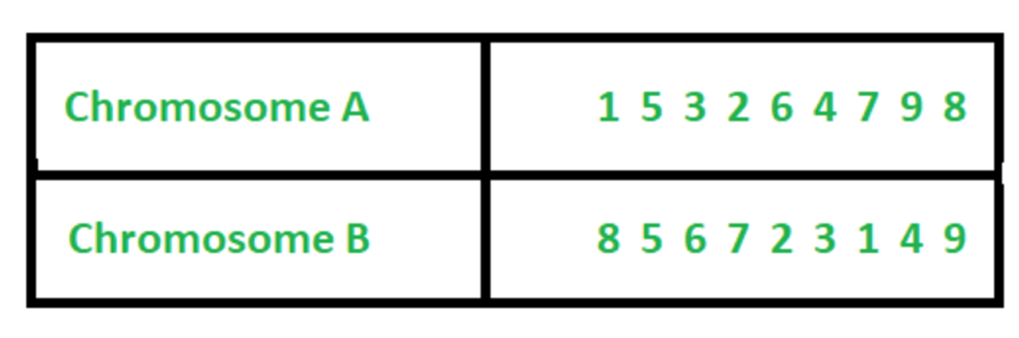
Encoding techniques
Permutation Encoding: Useful in ordering such as the Travelling Salesman Problem (TSP). In TSP, every chromosome is a string of numbers, each of which represents a city to be visited.

Slide 11
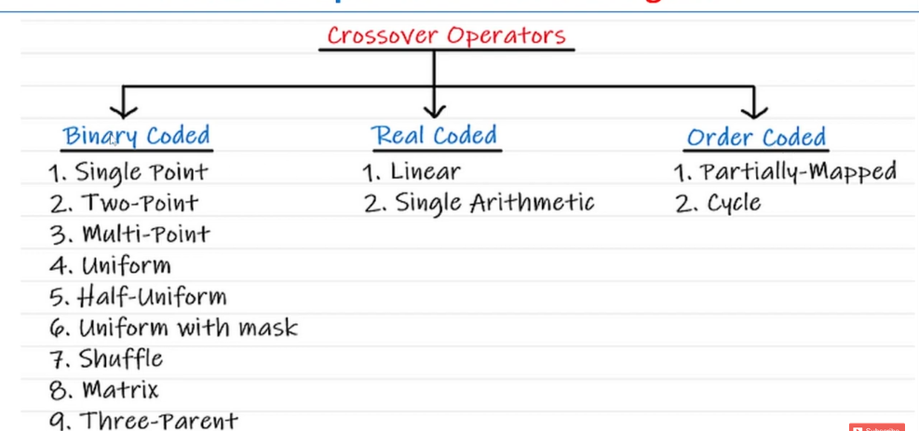

Slide 12
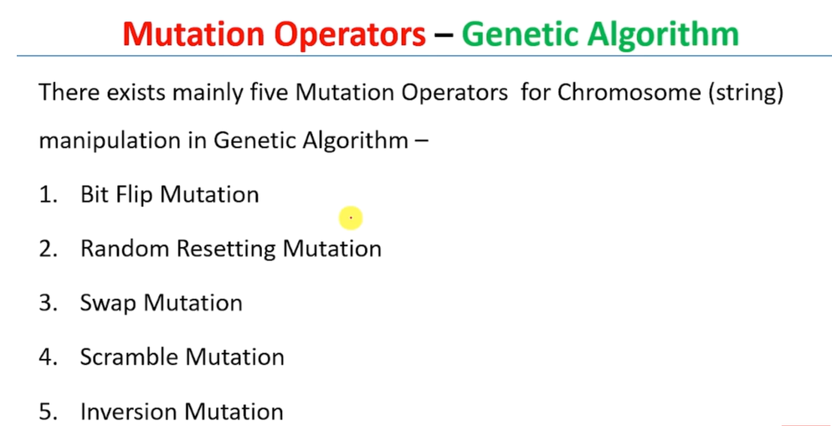
Mutation operators

Slide 13
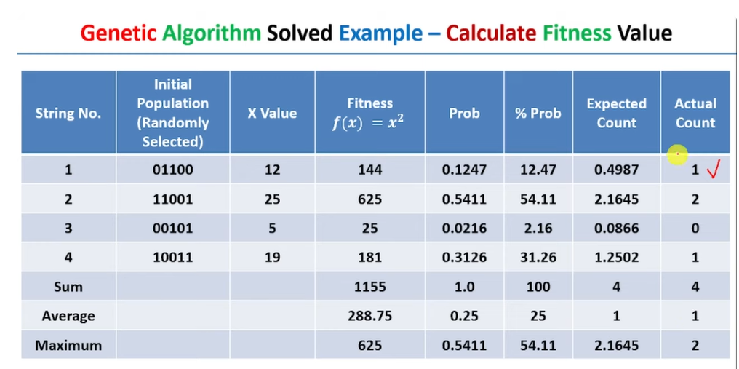

Slide 14
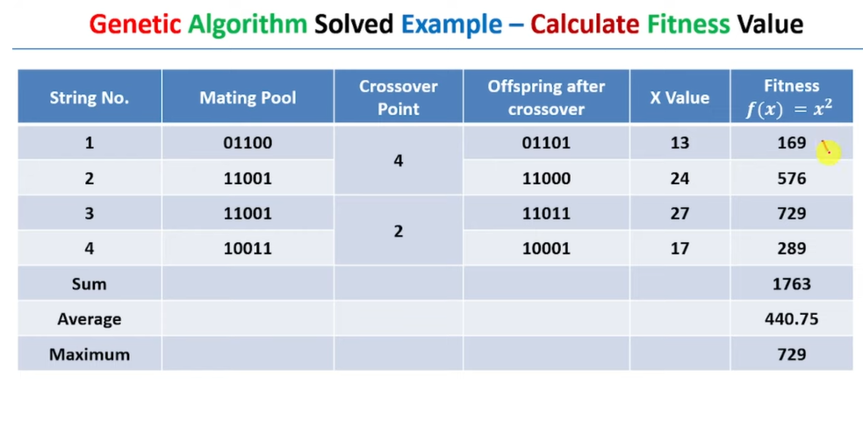

Slide 15
